Slide 1
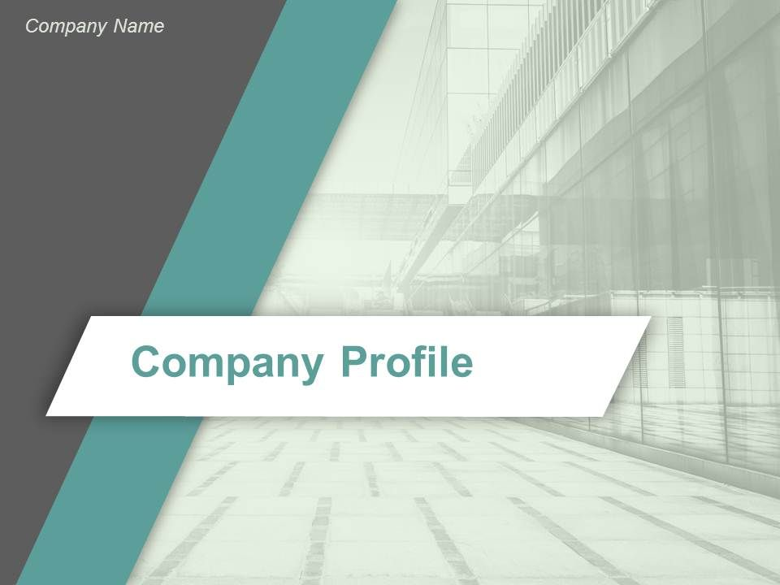
Neck Down Generation
Address: WEBEL IT PARK DURGAPUR, WEST BENGAL
Contact Number: 8250244283/ 6294244438
E-Mail ID: neckdowngeneration@gmail.com
PAN ID: AARFN8419M

Slide 2


Neck Down Generation
A bridge BETWEEN EMPLOYEE AND EMPLOYER….

Slide 3
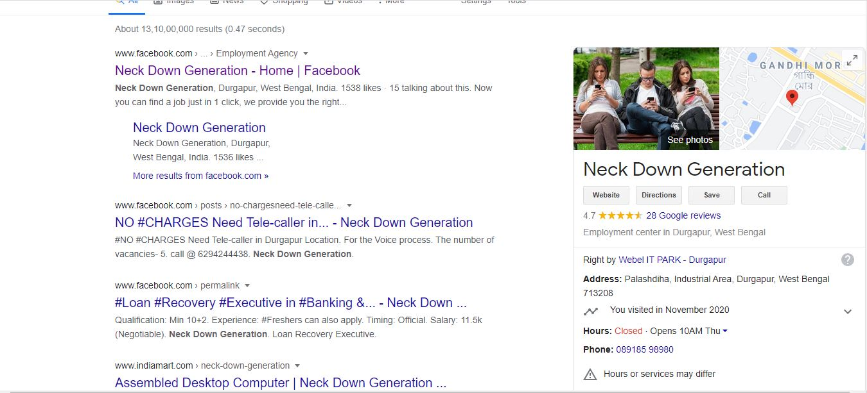

Slide 4




Agenda
About the Company
Our Story
Mission
Philosophy
Products and Services
Key Achievements
2020 Results
Performance
Survey Results
2021 Plans
Aspirations
New Initiatives
Closing

Slide 5

About NDG
Our Story
Mission
Philosophy
Products and Services
Key Achievements

Slide 6
About NDG
Our Story
Mission
Philosophy
Products and Services
Key Achievements

Slide 7

Our Story
Our story began in 2018, back then we have nothing but a dilapidated motorcycle and two young men obsessed to do something for all.
2020 was the pandemic year all because of covid-19, but in this hazardous condition our company providing employment and helping students by collaborating and assisting for there placement and education.

Slide 8

Mission & Vision
Our mission is to make a seamless relationship between the employee and the employer. And making the Youth by industries ready by providing the right counseling.
To show the light on the path which leads you to acme.
To provide a better opportunity in least efforts of yours.

Slide 9

Philosophy
Don't complain.
Take the responsibility to solve the problem.

Slide 10
Our Products and Services
CARRER & EDUCATION
Counseling
MANPOWER RECRUITMENT

Slide 11
Our consultancy
Strong education becomes strong stairs which leads you to great career , NDG construct these stairs and support you to climb up your desired height.
Through this we become your partner from C to C , college to career and this is what are mission is , to show the light on the path which leads a student to acme and them provide them better opportunity in least efforts of them.

Slide 12
Why NDG?
Because ,we understand you and your needs too , from in and out.
We provide you best doing deals within your financial boundaries by becoming a gate between your desire and your destiny.

Slide 13
MANPOWER SUPPLY
Hiring the right person for right role is not an easier job, moreover when you haven’t done before it can be challenging and super time consuming.one of the best solution for this is to hire NDG for this work. it will provide you cost-effective manpower supply services, negotiate on your behalf which helps you to be more flexible.

Slide 14
Why NDG?
because we accelerate the power of collaboration of generation.
we assure you quick and affordable manpower services .
We know that what our clients look for and we better know that how to fulfill there demand ,desire and needs too.
We doesn’t compromise in the matter of quality and always keeps quality on our first priority.
So chose the best expert in the town and join hand with us , as we would like to be your shining star in the field of manpower supply.

Slide 15

Key Achievements
Celebration the big wins and memorable moments.
More than 10 Company’s Tie-up (Technical)
More than 15 Colleges tie-up (Technical & Non Technical)
Successfully Placed more than 78 Candidates in the last 3 months…..

Slide 16
2020 Results
Performance
Survey Results

Slide 17
2020 Performance

Slide 18
Survey Results (Job Opening)

Slide 19
2021 Plans
Aspirations
New Initiatives
Key Metrics

Slide 20
2020 Plans
Aspirations
New Initiatives

Slide 21

Aspirations
There is only way to live your life :-
One understand the situation and adjust
2nd take responsibility to change it.
AND we are ready to take the responsibility……

Slide 22

New 2021 Initiatives
What is our keys plans for the coming year?
Technical and Non Technical College/ Institute/ Training Center Tie up.
Technical/ Non Technical Job Generate.
Try to work with Govt simultaneously to resolve the unemployment issue.
Open a BPO & KPO.
Increased the count of IT support customers.

Slide 23

Projects
We worked as a sourcing agent on the behalf of Centurion University of Technology and Management.
Working on the project of NEEM (National employment enhancement mission), and GRAM TARANG (Gram Tarang Employability Training Services)
Flexi ITI

Slide 24
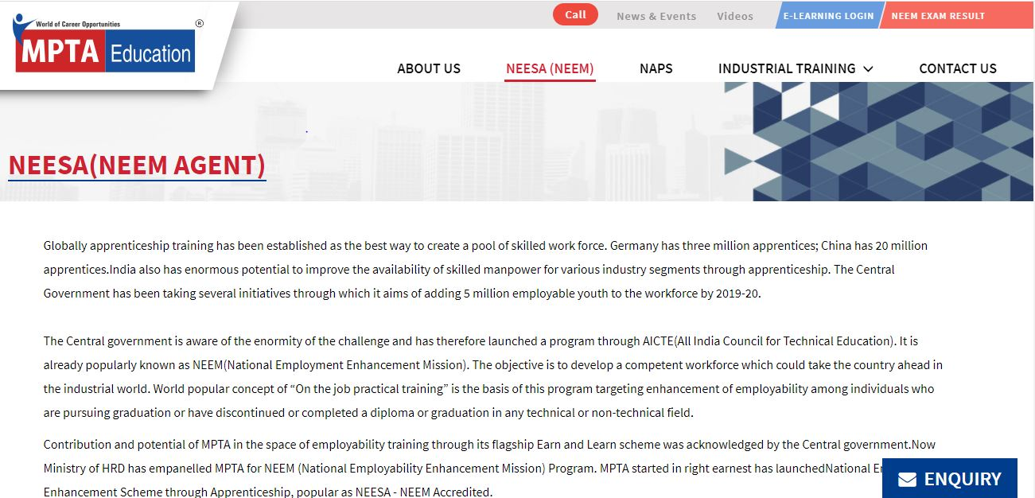
NEEM (National Employment Enhancement Mission)

Slide 25
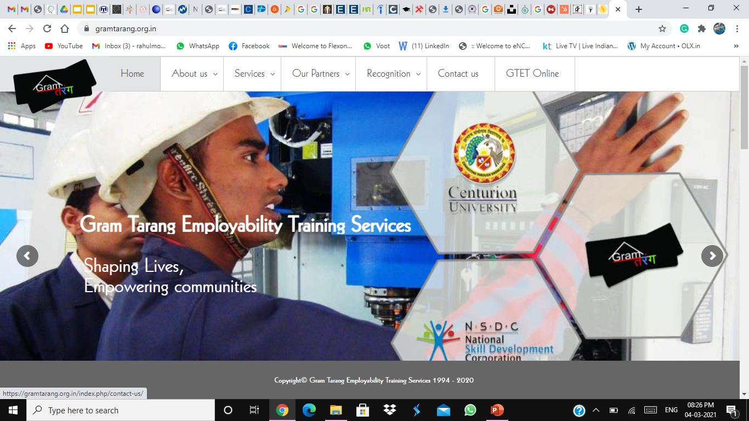
Gram Tarang Employability Training Services

Slide 26
Thank you

